Slide 1
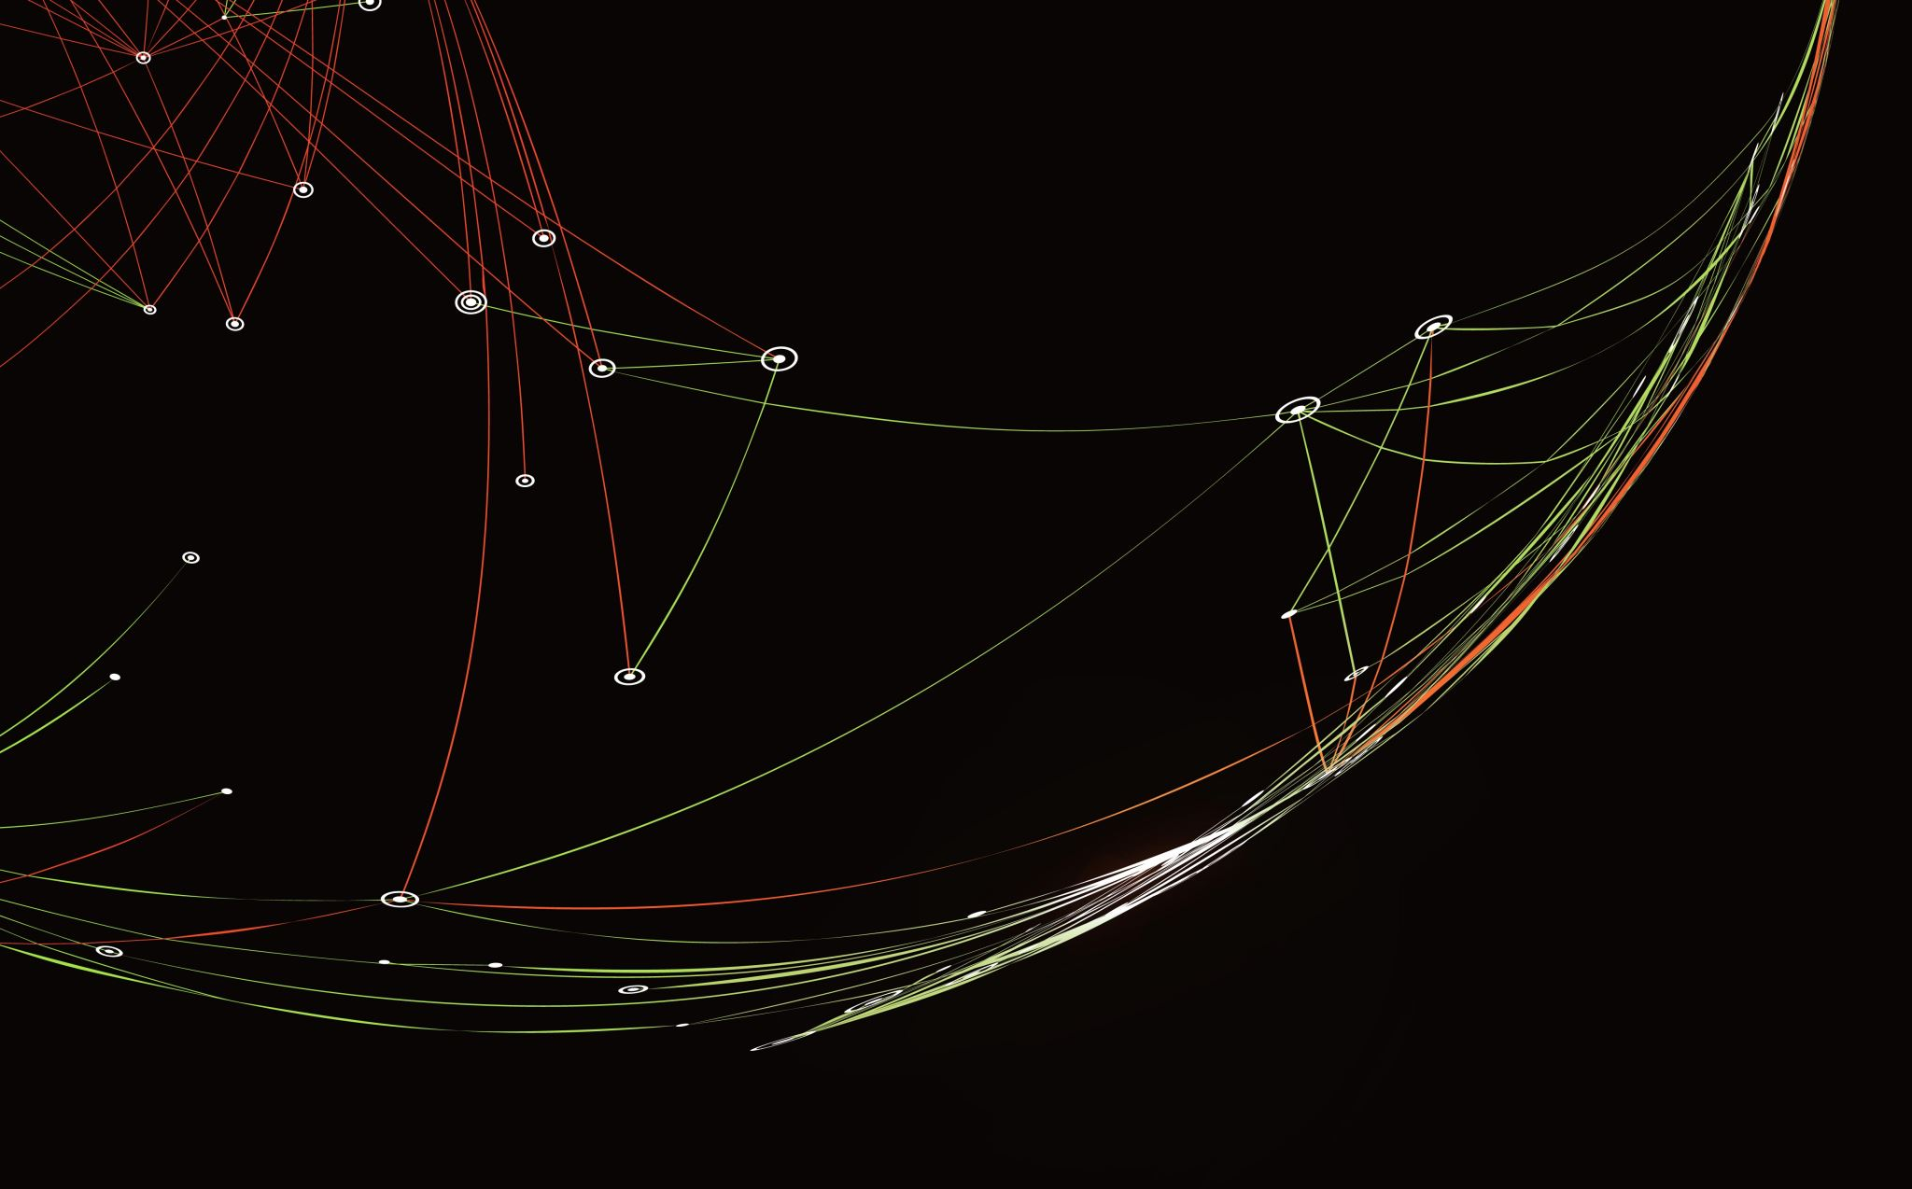
People Counting system
-Gnana Surya Teja(RA2011026010151)
-Bhogabhavish(RA2011026010149)

Slide 2
Problem Statement
When people visit a building, school, malls we need to keep a track of the people entering the building either for security purpose, or suppose if it’s a mall or shopping center for business purpose to track the people, we need to keep a track on number of people who enter or leave the premises, for the same to count the people manually it is difficult and it takes lot of man power to do so, for which we need to invest money also. With this People Counter project here we save the money, man power and most importantly the TIME.

Slide 3
Methodology
The objective is to build a system that has the following features.
Read the frames from the Video.
Draw a desired reference line on the input frame.
Detect the people using the object detection model.
Mark the centroid on the detected person.
Track the movement of that marked centroid.
Calculate the direction of centroid movement (whether it is moving upwards or downwards).
Count the number of people coming in or going out of a reference line.
Based on the counting, increment the up or down counter.

Slide 4
Algorithm
We can build the deep learning project locally since it does not have many dependencies. Install the libraries:
pip install numpy
pip install opencv-python==3.4.2.16
Then we need a python file for Centroidtracker.
Here we will use YOLO v3 as our model for detecting the person in the frame. So we need to download YOLO v3 weights and YOLO v3 configuration files as well as the coco classes that is coco.names file.

Slide 5
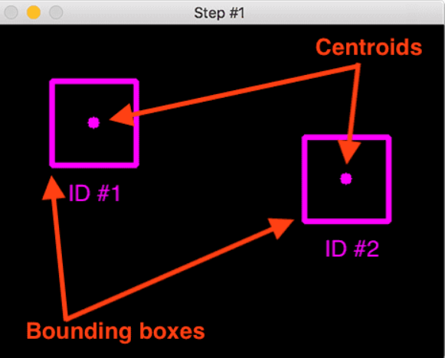
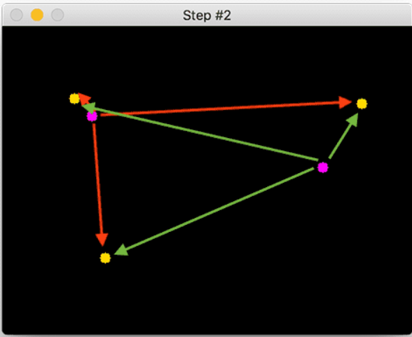
Centroid Tracking

Slide 6
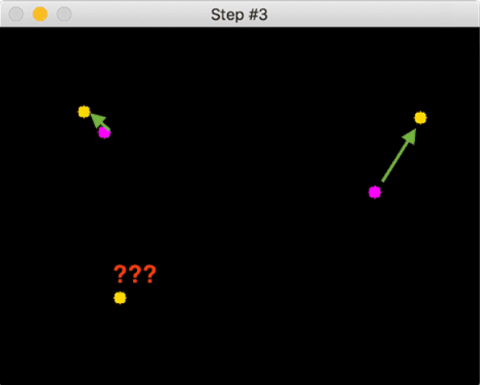
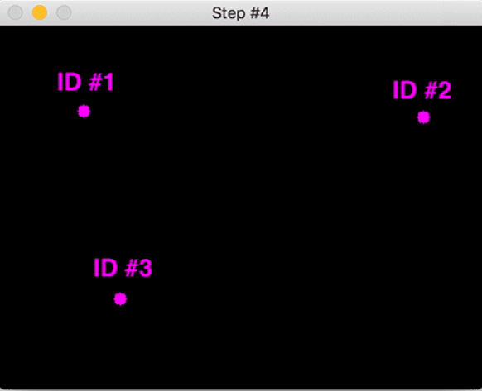
Centroid Tracking

Slide 7
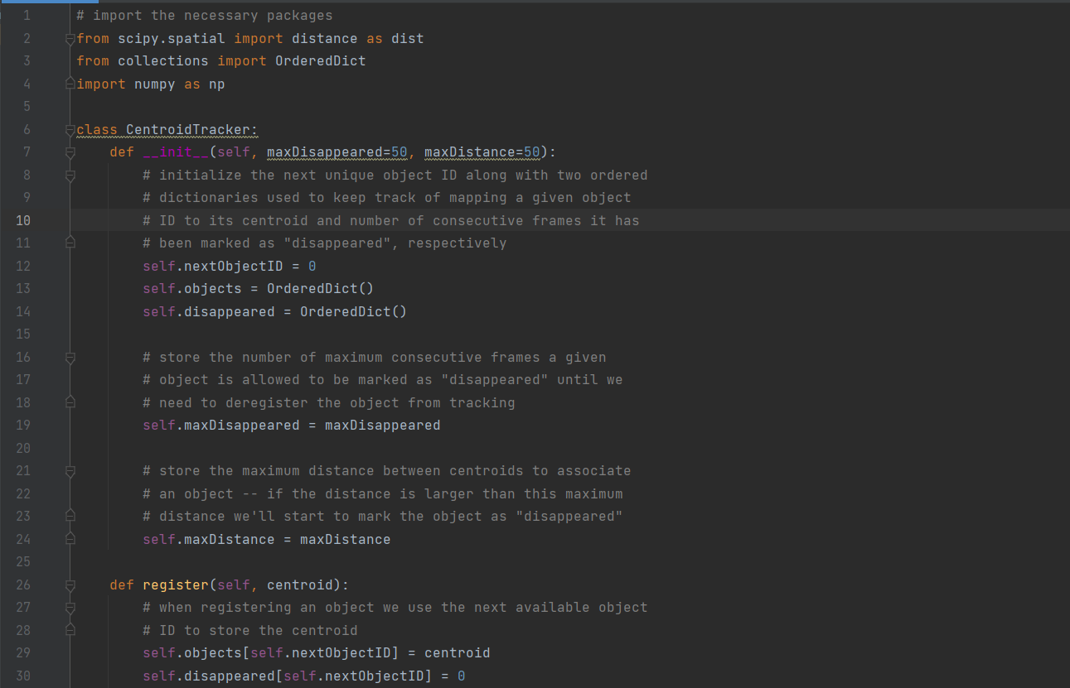
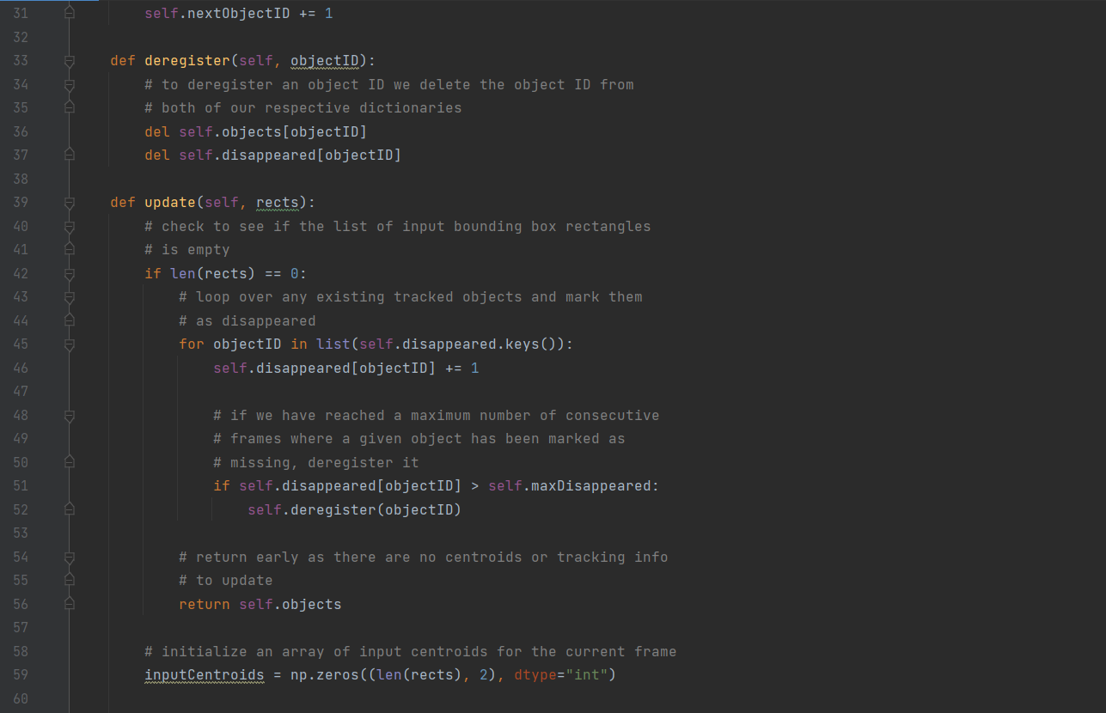
Code used to Develop this Project

Slide 8
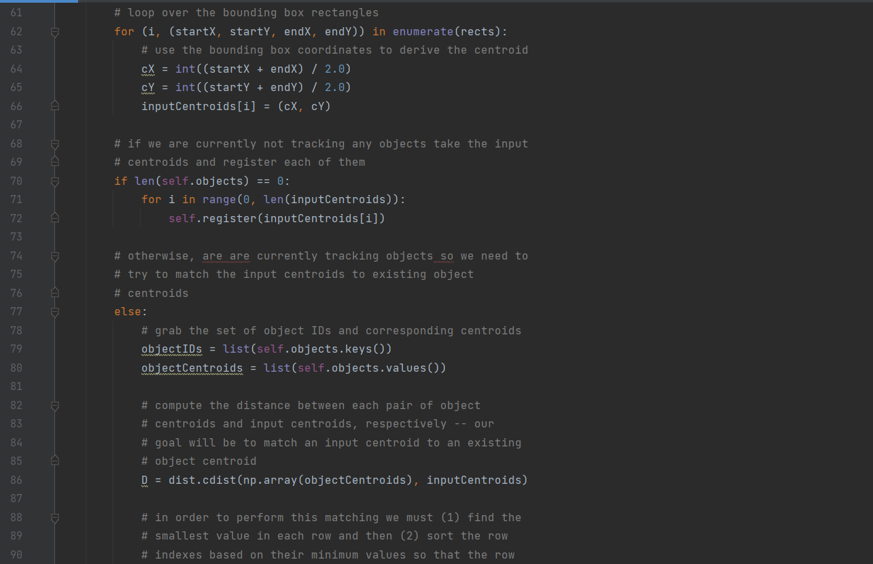
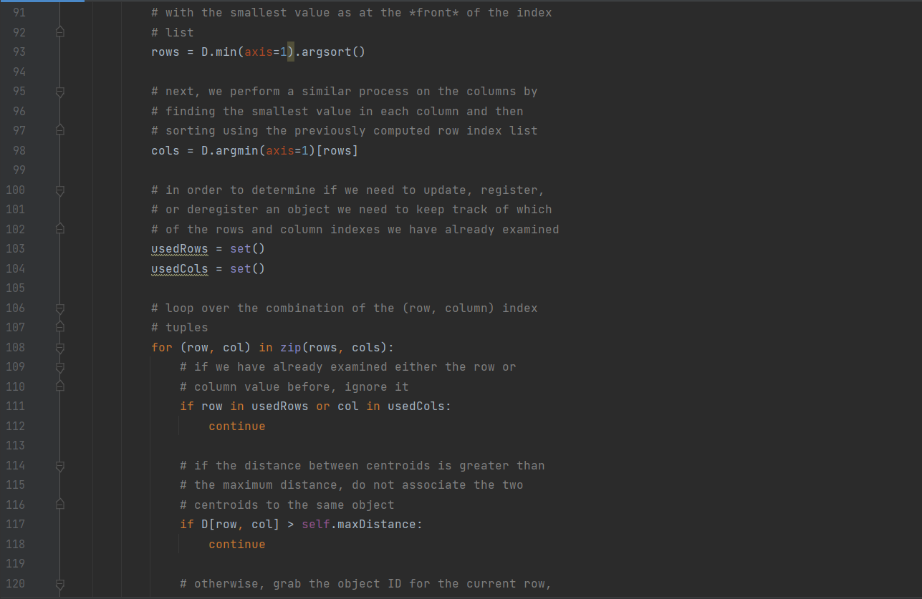
Code

Slide 9
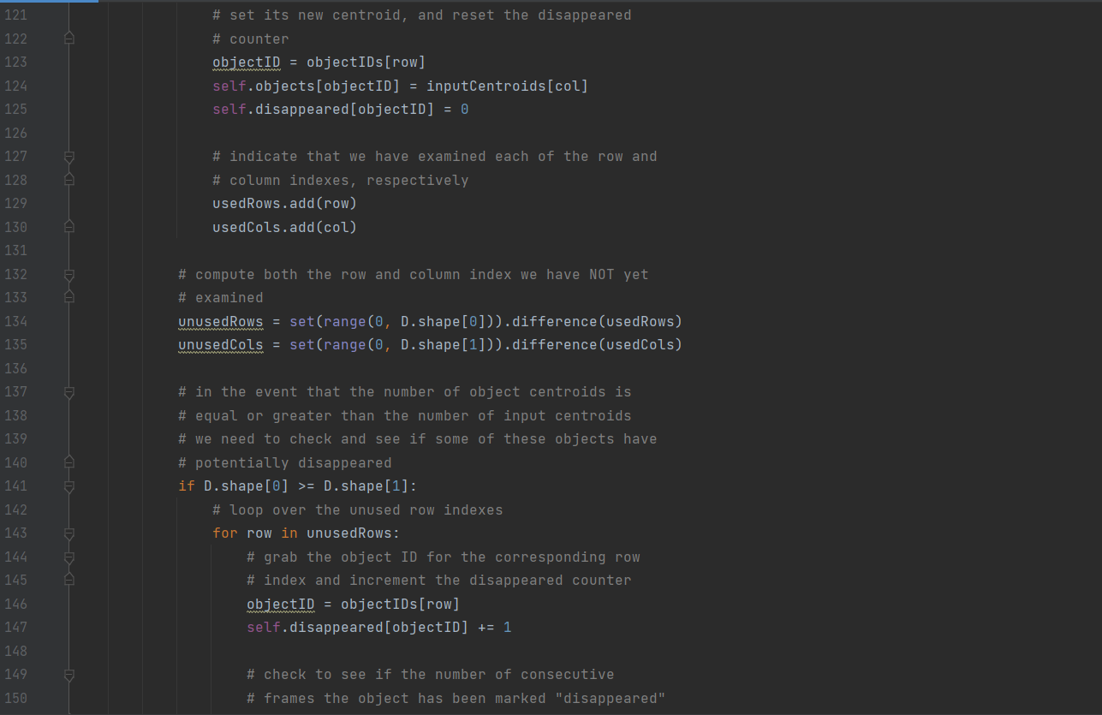
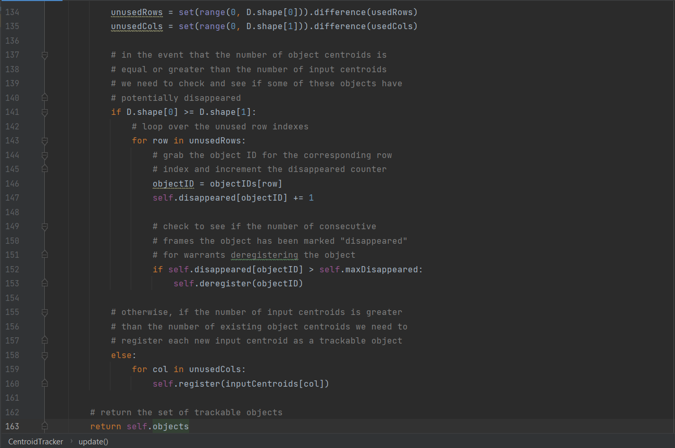
Code

Slide 10

Data Set Information
The Original Data Set taken for this particular project is of a CCTV footage where people enter and leave the building. Using this particular video we have developed the whole project.

Slide 11
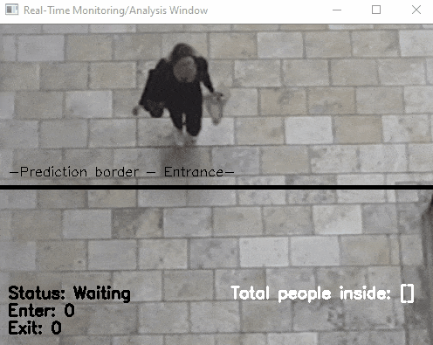
Data Set Information
After implementing the People Counter, the taken Dataset gives the following output as shown in the video attached here.

Slide 12

Thank You

